Slide 1
Guest management with the Power Platform & the Microsoft Graph
Simon Ågren

Slide 2
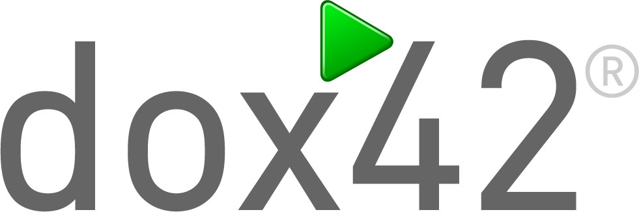









Sponsors and Partners

Slide 3







@agrenpoint https://simonagren.github.io https://github.com/simonagren https://www.linkedin.com/in/simonaagren
About me
Simon Ågren
Solution Architect & Office Development MVP

Slide 4
Agenda
Power Platform intro
Graph Intro
Background
Sharing settings
Architecture
Walking through the different parts
Demo

Slide 5
Microsoft Power Platform intro
A brief overview

Slide 6
PowerApps
Power BI
Microsoft Flow
Dynamics 365
Microsoft Power platform
Azure
Office 365
Standalone Apps
Common Data Service for Apps and
Data Connectors

Slide 7
PowerApps
An application Platform as a Service (aPaaS) for citizen-developers to build high-productivity business apps

Slide 8

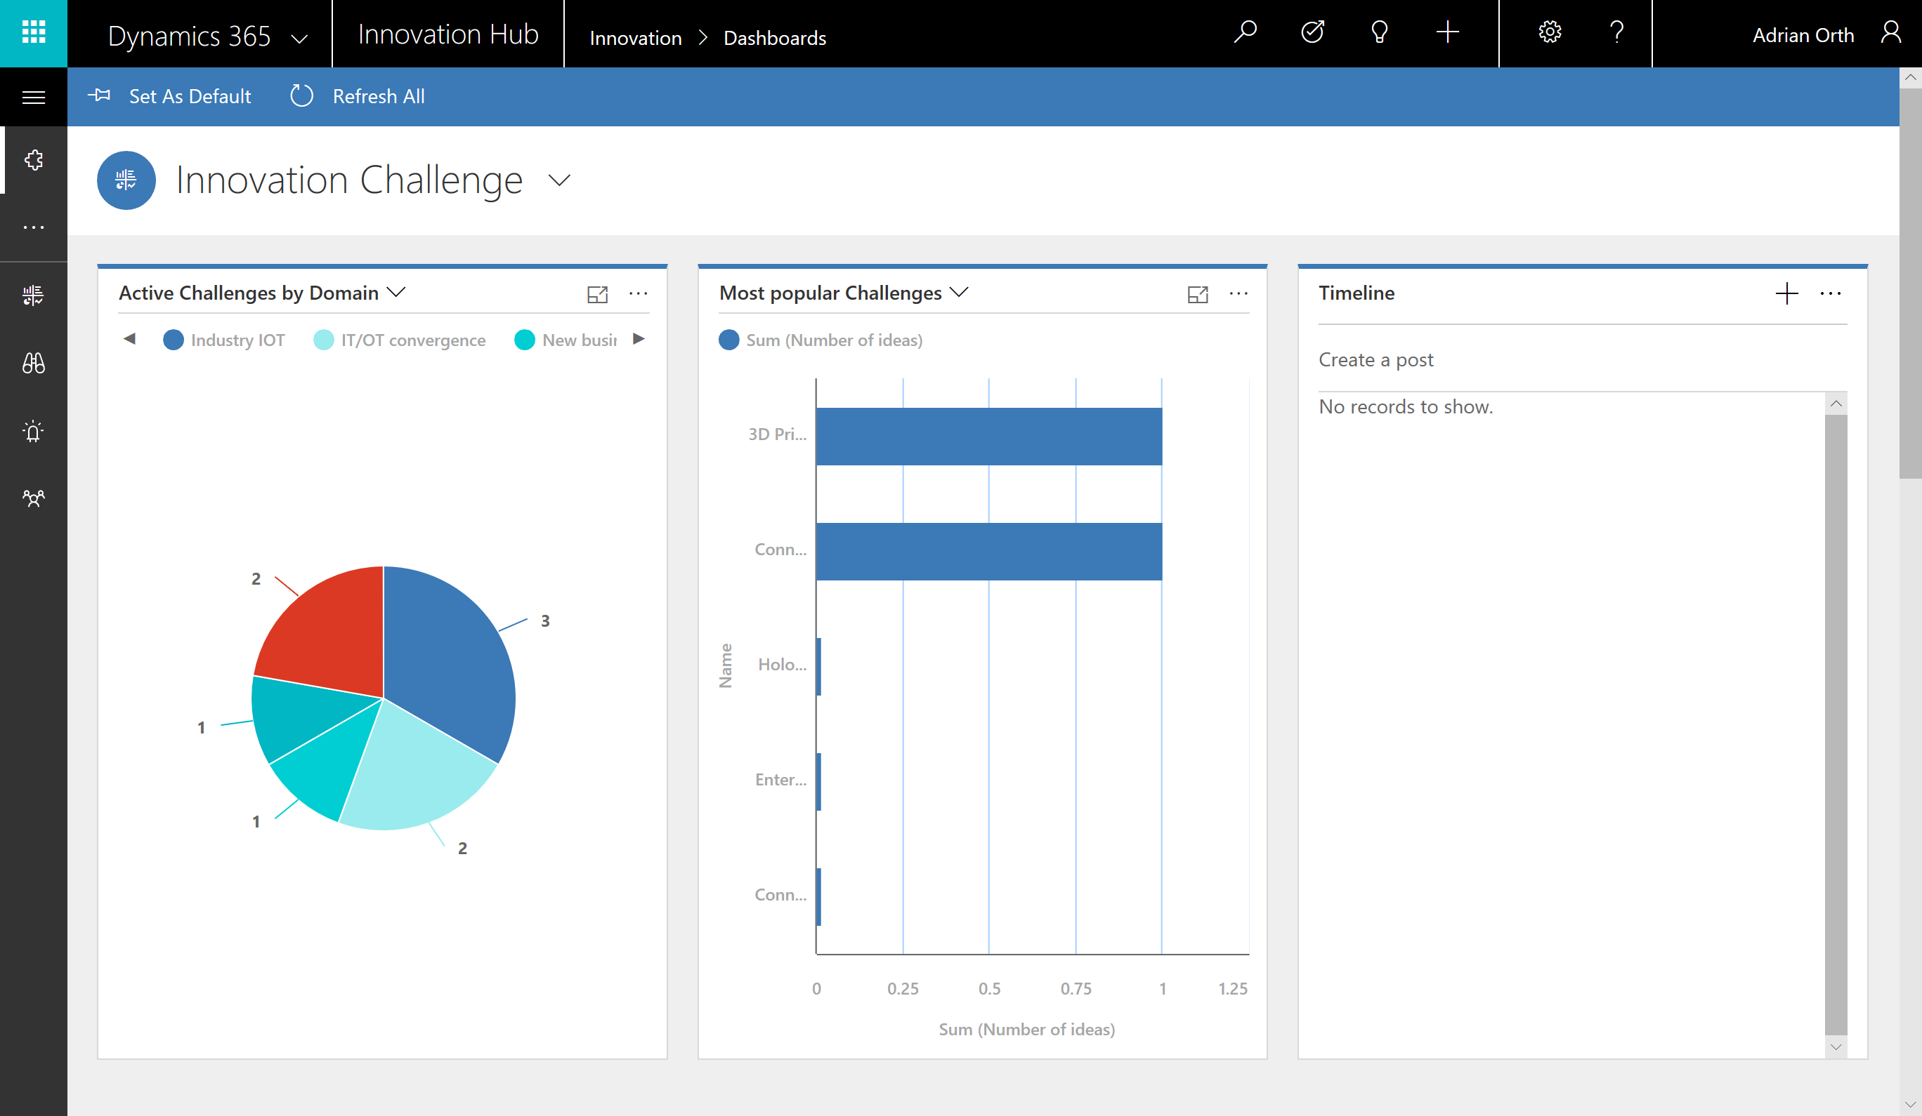

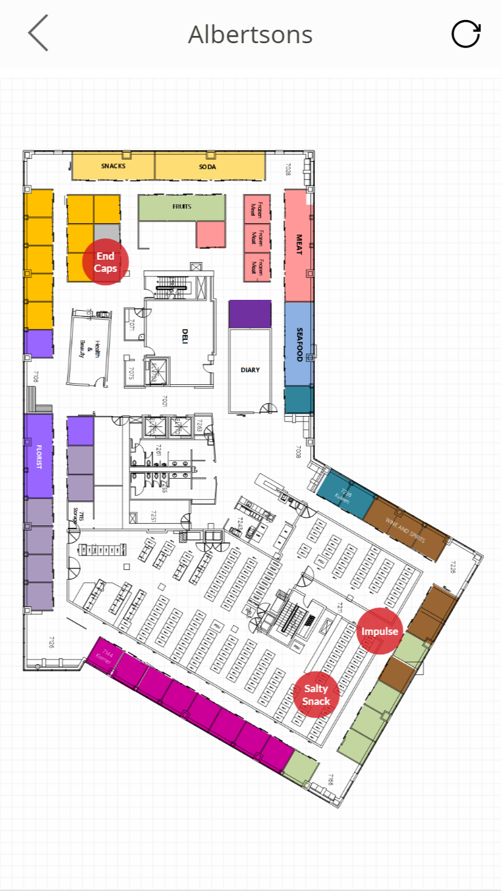
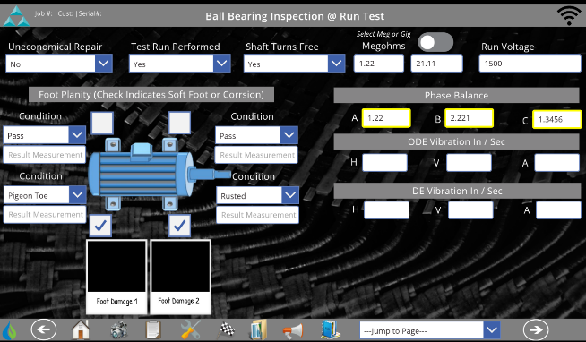
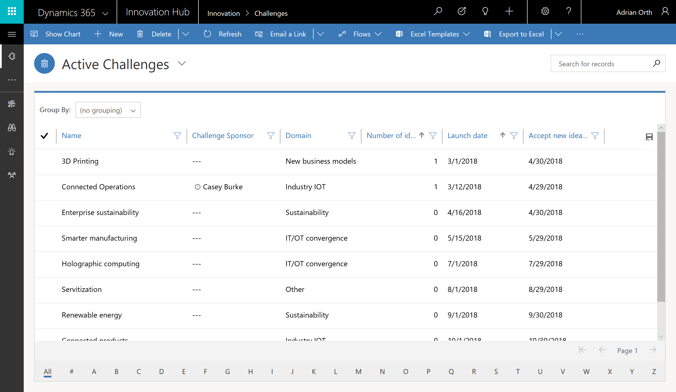
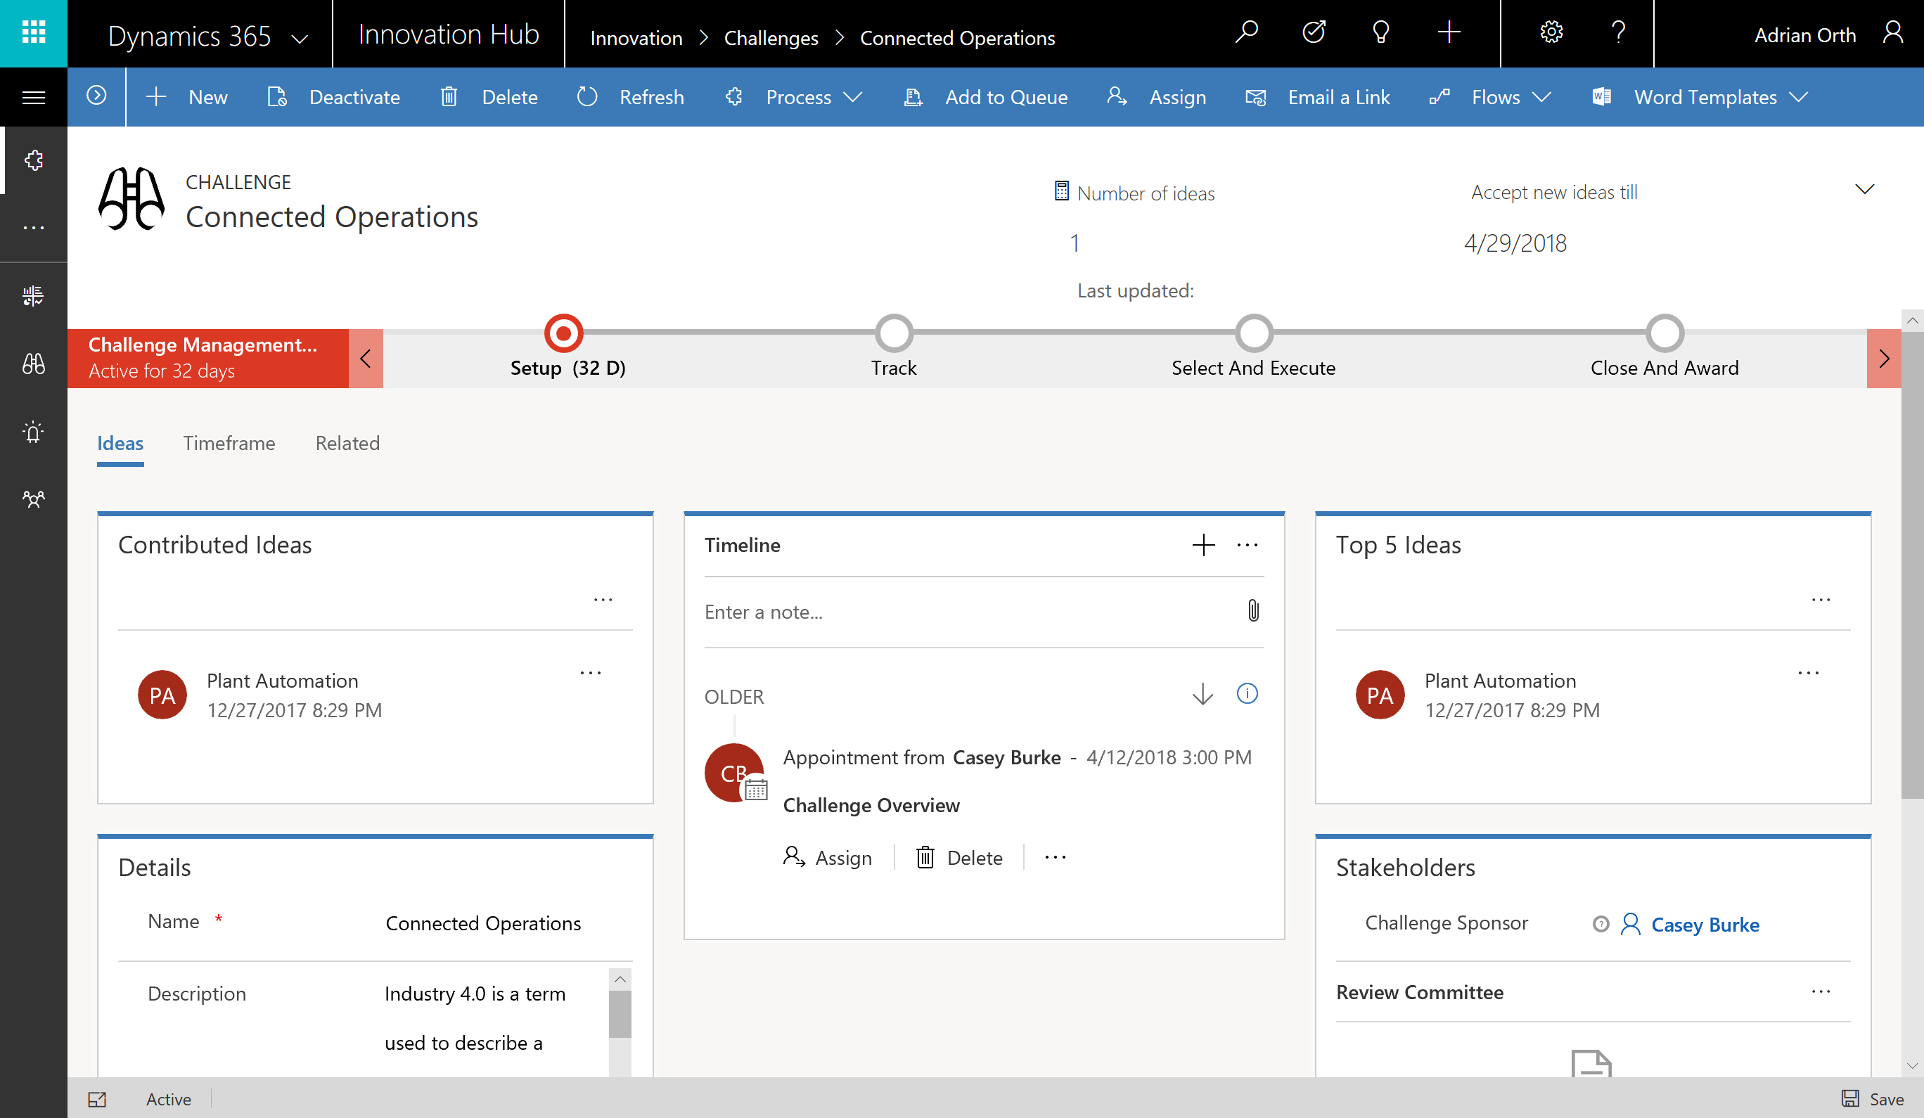
Types of PowerApps apps
Canvas apps start with user experience, with pixel-perfect control to build highly customized task- and role-based apps that mash up data from 230+ sources
Model-driven apps leverage your data model, relationships, and business processes to automatically generate immersive, responsive applications

Slide 9
PowerApps
Power BI
Microsoft Flow
Dynamics 365
Microsoft Power platform
Azure
Office 365
Standalone Apps
Common Data Service for Apps and
Data Connectors

Slide 10
Microsoft Flow
Microsoft Flow is a service for business users
to automate workflows across apps and services

Slide 11
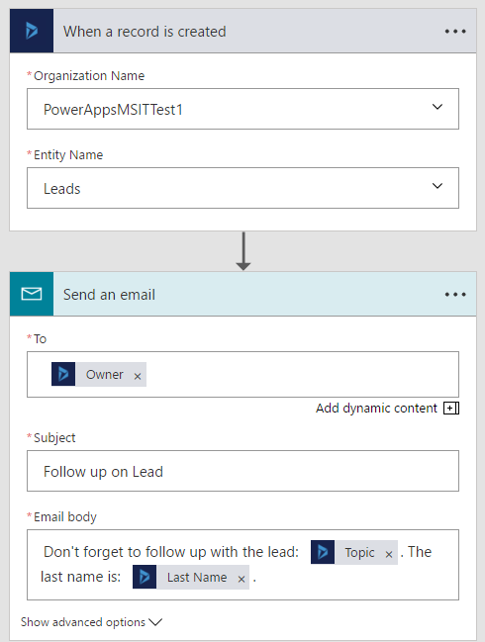
What makes up a flow?
Starts with an event or trigger (Manual, On a schedule, Event driven)
Performs any number of actions Action: What does the flow do?
Can have conditional logic (If then else, Case)
Data flows between trigger and actions to subsequent actions
Example: Notification on a new record in Dynamics 365

Slide 12
Four types of flows
Automated flows
Scheduled flows
Business process flows
Instant flows

Slide 13
PowerApps
Power BI
Microsoft Flow
Dynamics 365
Microsoft Power platform
Azure
Office 365
Standalone Apps
Common Data Service for Apps and
Data Connectors

Slide 14
Power BI: experience your data Any data, any way, anywhere
Web
Real time dashboards and interactive reports
Mobile
Natural Language query
Excel
Cloud data
Custom visualizations
Embedded
Native Office 365, Dynamics 365, Azure integration
Cortana
On-premises data
Power BI
“……”

Slide 15
Microsoft Graph Intro
Brief introduction

Slide 16
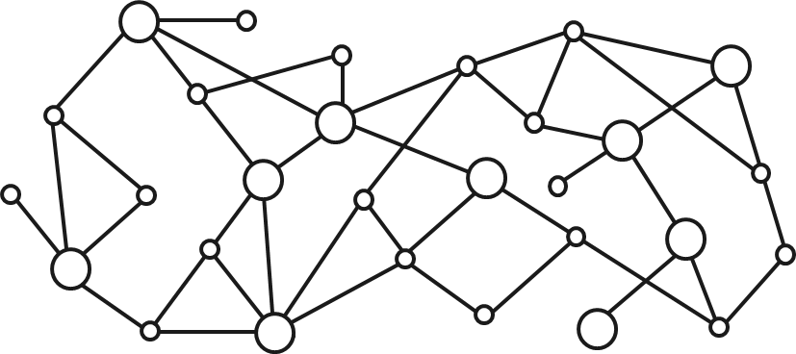
Gateway to your data in the Microsoft cloud
Your app
Web Apps
Device & Native
Apps
Bots
Background
processes
1
Gateway
Microsoft Graph
Office 365
Windows 10
Enterprise Mobility + Security
Your or your customer’s data
Microsoft identity
Rich content
Deep insights
Real-time updates

Slide 17
Background
Notes:
At a customers with one of our sales representatives
They are a manufacturing company with a lof of consultants working temporarilly at the company.
They expressed a concern about the challanges of administering the consultants.
So I just though about what if we could automate this for you? Which sparked an idea.
And this solution could be done multiple ways, the purpose of today is not to provide the ultimate solution.
Give you some ideas of how we could this
Something to build upon and make your own

Slide 18
Sharing settings
Limiting sharing to already existing guests

Slide 19
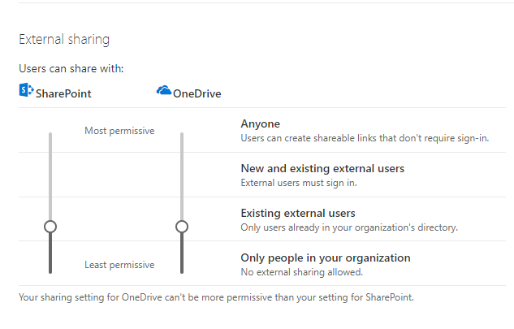
Settings in OneDrive and SharePoint
Go to the OneDrive Admin Center and adjust levels for both SharePoint and OneDrive

Slide 20
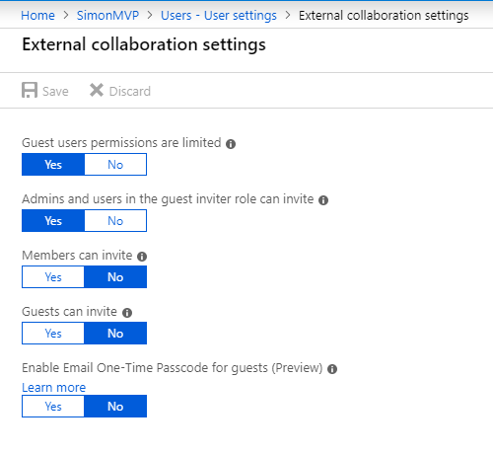
Settings in Azure AD
Go to the your Azure AD in the Azure Portal

Slide 21
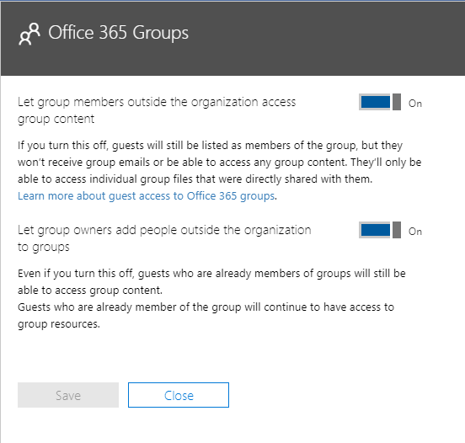
Settings in Office 365
Go to the admin center, then settings -> services & add-ins -> Control settings for Office 365 groups

Slide 22
Architecture
High level architecture and explanation

Slide 23








Azure AD
Microsoft Graph
SharePoint Online
Flow
(Get Sites In Hub)
Office 365 Groups
Azure Function
(CreateInvitation)
Azure Function
(UpdateInvitation)
Azure Function
(DeleteInvitation)
Custom Connector
Flow
(Remove Invitation)
Flow
(Update Invitation)
PowerApps
PowerBI

Slide 24
Why this approach?
Recommended approach
More control within the PowerApp
Implications of other ways
What does this mean regarding licenses
Notes:
A lot of discussion regarding licenses since the change in premium licenses etc.
You may have seen a lot of different ways
To call Azure Functions directly from the PowerApps is recommended.
We have more control regarding the result
Reflected in the PowerApp directly by a toast etc
You can do this other ways but not as clean regarding triggering a Flow etc. You could use Logic apps etc
I do this in SharePoint now creating lists, etc. for data storage.
It could be a CDS entity.
This could be exported by using solutions.
A solutions is a package and could contain: PA, Flow, Entities etc
It would be easier to just import the solution and BAM, you are kinda done.
Regarding licensing this requires all the PA users to have P1, and an additional P1 for the recurrent Flows, and you do need ex. E5 for the BI Pro.

Slide 25
Solution walktrough
The different bits and pieces explained

Slide 26
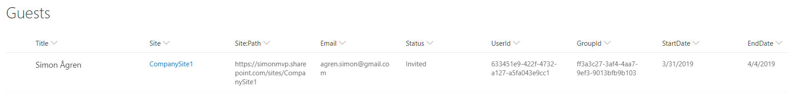
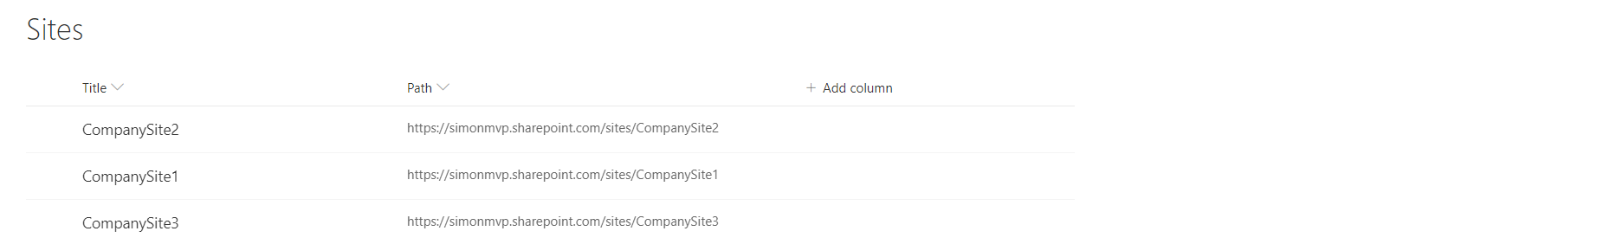
SharePoint
A custom list to hold both pending invitations and fully invited guests.
The start date can be used in scheduled invites and the end date for automatic removal of invites
A custom list to hold all the associated sites within a specific hub called CompanyHub.
Used as a lookup field in the Guests list

Slide 27
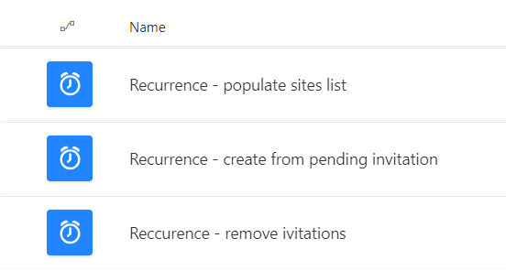
Flows
Utilizes SharePoint search API to retrieve the associated sites in the hub.
_api/search/query?querytext=‘
DepartmentId:{029afe96-f212-4b9d-a5d8-a8dfdc3028d8}
contentclass:STS_Site NOT siteId: 029afe96-f212-4b9d-a5d8-a8dfdc3028d8’
&selectproperties='Title,Path,DepartmentId’
&Properties='EnableDynamicGroups:true'

Slide 28
Flows
Gets all items from the Guest list in SharePoint where:
Status is pending
Start date is equal to today.
For each item the Flow uses the custom connector to:
Create an invitation based on the list data
Update the item with the userId and groupId

Slide 29
Flows
Gets all items from the Guest list in SharePoint where:
End date is equal to today.
For each Pending item the Flow uses the custom connector to:
Delete the list item
For each Invited item the Flow uses the custom connector to:
Remove the invitation
Delete the list item

Slide 30
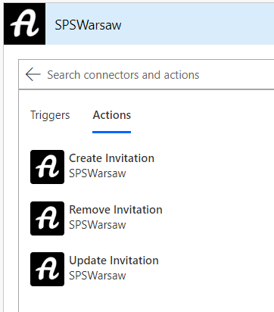
Custom Connector
Created from the UI
Could create from Postman collection or OpenAPI
Connects to an Azure AD secured application
Application Id and Secret
Three actions available in Flow and PowerApps
Mapped to the specific Azure Functions within the Function App
Request body and default response

Slide 31
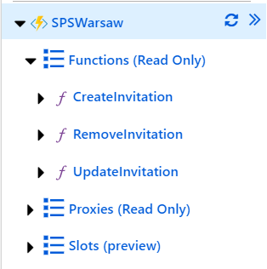
Azure Functions
Created a Function App that contains the Azure Functions
Created from Visual Studio Code
Azure Functions extension
Node.js and TypeScript
Using PnPJs
Azure AD secured
Using key vault for the Application Secret
@Microsoft.KeyVault(SecretUri=https://spswarsawvault.vault.azure.net/secrets/graphSecret/…)
Notes:
Key vault syntax from app settings, no code needed for key vault

Slide 32
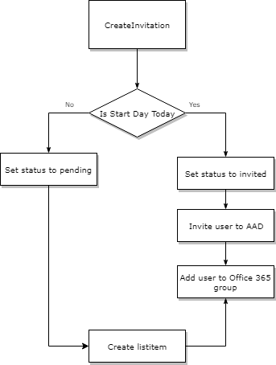
Create Invitation
Title
Email
redirectUrl
siteName
siteLookupId
startDate (optional) / Today
endDate

Slide 33
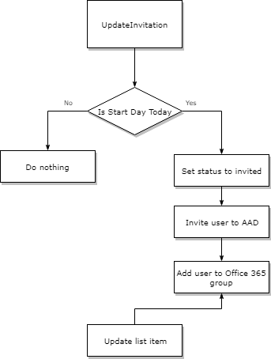
Update Invitation
itemId
email
redirectUrl
siteName
siteLookupId
startDate

Slide 34
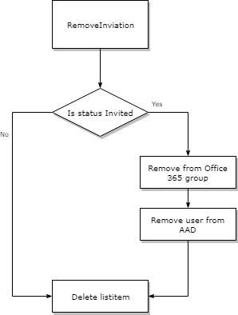
Remove invitation
itemId
email
userId
groupId
status

Slide 35
Demo

Slide 36
Questions?

